Slide 1
Exemplary - CAR 133912839 ?
December 2014

Slide 2
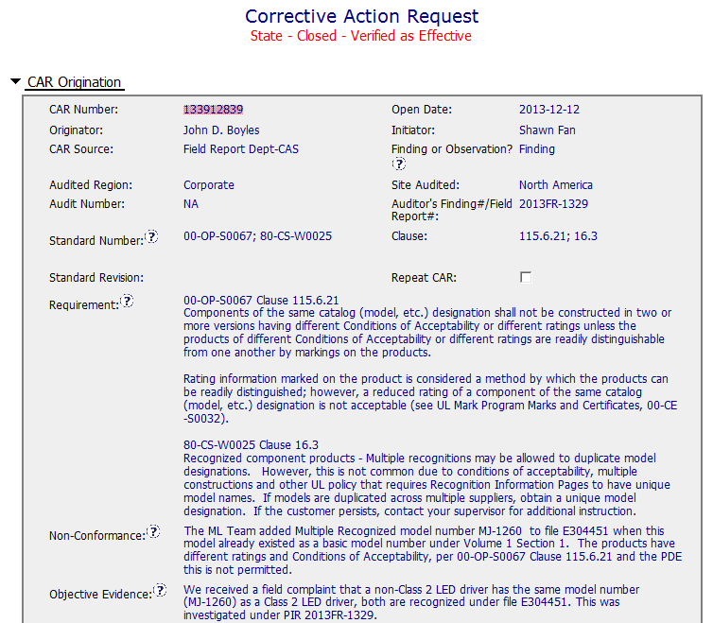
Exemplary - CAR 133912839 ?
CAR is well written with specific information

Slide 3
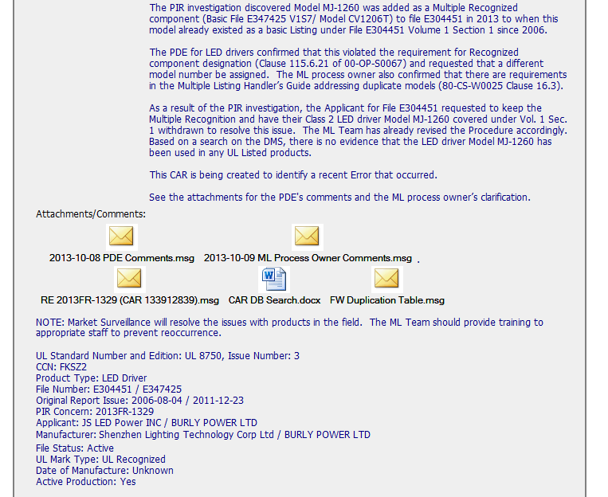
Exemplary - CAR 133912839 ?
PDE consulted
Supporting information provided

Slide 4
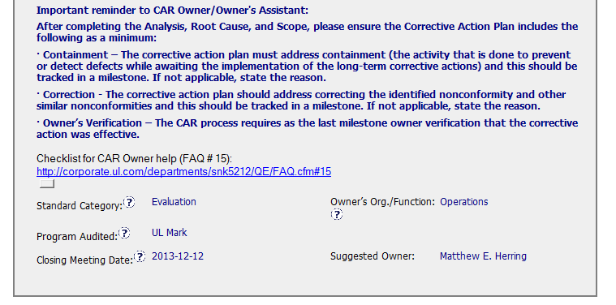
Exemplary - CAR 133912839 ?
Guidance provided
Links to relevant FAQs
Correct owner

Slide 5
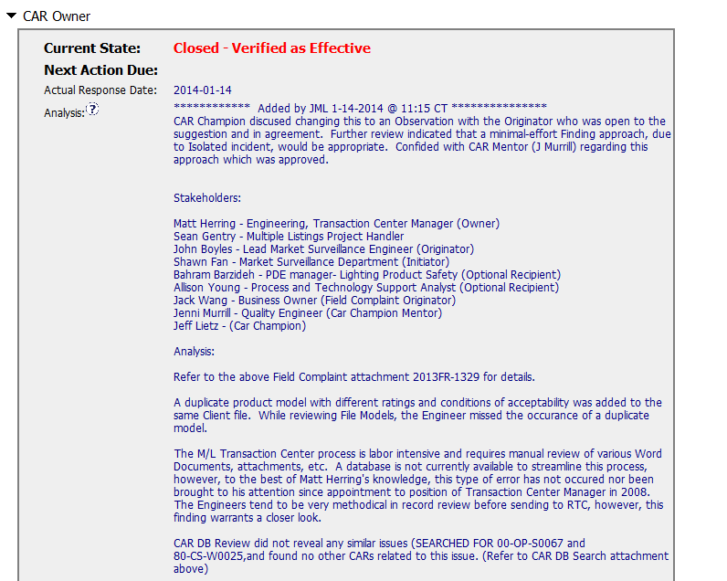
Exemplary - CAR 133912839 ?
Rationale notes included
Minimal effort-finding approach?
Stakeholders consulted

Slide 6
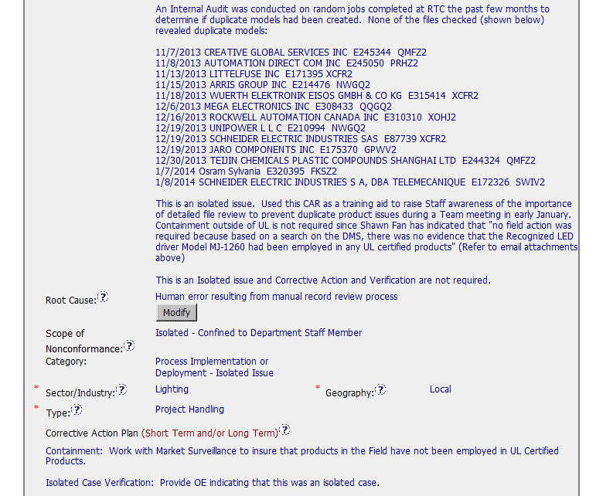
Exemplary - CAR 133912839 ?
Well scoped
Human error ?

Slide 7
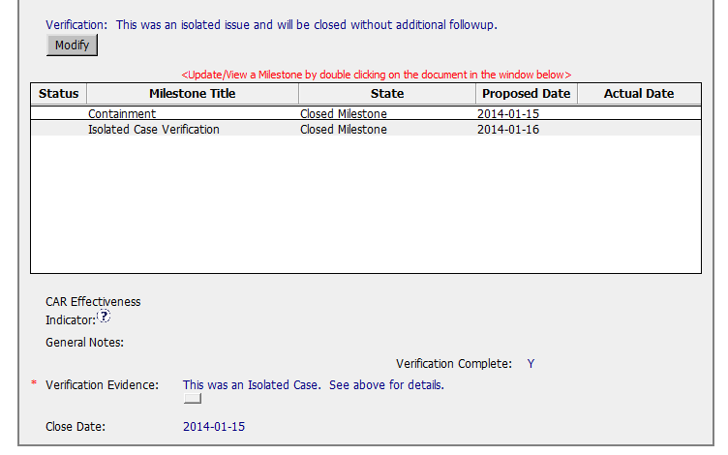
Exemplary - CAR 133912839 ?
May need to consider other ML handlers
Limitation of the CAR is scoping – may necessitate Root Cause revision and CA plan to be changed.

